Slide 1
Universal Windows Platform
Oleksandr Krakovetskyi
CEO, DevRain Solutions
http://devrain.com
alex.Krakovetskiy@devrain.com

Slide 2
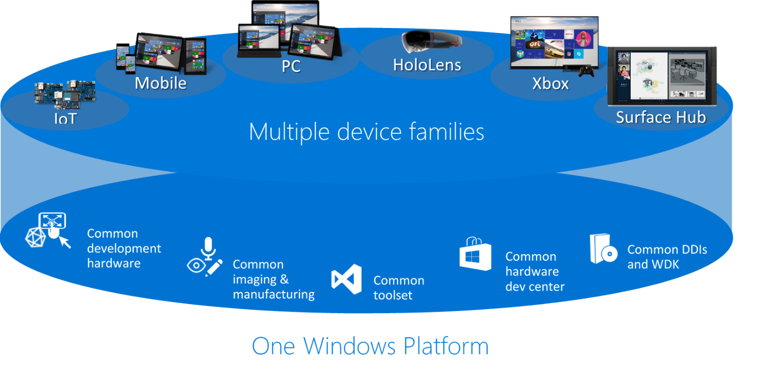
Universal Windows Platform

Slide 3

Universal Windows Platform
Wherever your code was born, you can bring it to Windows
Windows Platform
Web Platform
Universal Windows 8 Apps (C++/C#/JS)
Microsoft Edge HTML Engine
Universal Windows 10 Apps (C++/C#/JS)
Surface Hub
Desktop
Cordova Tooling (HTML/JS)
Project Centennial (Classic Apps)
Hosted Web Apps (HTML/JS)
Universal Windows Platform
IoT
Xbox
Middleware Platforms
Other Mobile Platforms
Middleware Partners (e.g., Xamarin)
Holographic
Mobile
Project Astoria (Java/C++)
Game Engine Partners (e.g., Unity)
Project Islandwood (Objective C/C++)

Slide 4
Universal Windows Platform Bridges
https://dev.windows.com/en-US/uwp-bridges
Windows Bridge for Android (”Project Astoria”) will enable you to build apps using Android code to target Windows 10 phones without having to leave your Android IDE.
Windows Bridge for iOS (”Project Islandwood”) will enable you to build a universal Windows app from within Visual Studio 2015 using your existing Objective-C code.
Windows Bridge for Classic Windows apps (”Project Centennial”) will make it possible to package and publish your current .NET and Win32-based Windows applications to the Windows Store, providing a new way of distributing and monetizing your application on Windows PCs.
Windows Bridge for web (”Project Westminster”). Windows 10 will make it easy for you to create a Windows app that packages your website for publishing to the Store. Once installed, your website can update and call Windows APIs from JavaScript, creating a more engaging user experience.

Slide 5
Windows Bridge for Android («Project Astoria»)
Helps developers port their Android apps to the Universal Windows Platform.
The goal is to allow apps to be ported with as minimum code changes as possible, desirably none
Both Java and native Android code (C, C++) is accepted. IDEs: IntelliJ, Android Studio and Eclipse on Windows or Mac OS X machines.
Gradle can be used to generate builds for both Android and Windows from the same source without requiring code forking.
The SDK comes with a Windows emulator and the code can be deployed to real devices via USB or WiFi. Debugging works as usual for any other Android application.
KitKat is currently supported.
Targets Android mobile apps, and they will be ported only to phones and tablets, not to HoloLens, desktop or other Windows devices.

Slide 6
Windows Bridge for Android («Project Astoria»)
Helps developers port their Android apps to the Universal Windows Platform.
The UI is converted to a native Windows one, but there are limitations on what can be done.
Porting works by redirecting Android OS calls to their corresponding Windows operations, without introducing any intermediary VM or runtime. This is done to avoid unnecessary CPU consumption which is important on mobile devices.
Google Play services calls - Ads, Analytics, In-app purchases and Notifications - are automatically redirected to corresponding Windows services without source code change. Bing Maps is used instead of Google Maps. Calls to Android device sensors, buttons or features, such as Contacts, Share, keyboard, are also mapped to Windows ones.
Windows specific code, such as Live Tiles, is added using Java.

Slide 7
Use your existing code and tools
DEMO
Building a Windows app with "Project Astoria”

Slide 8




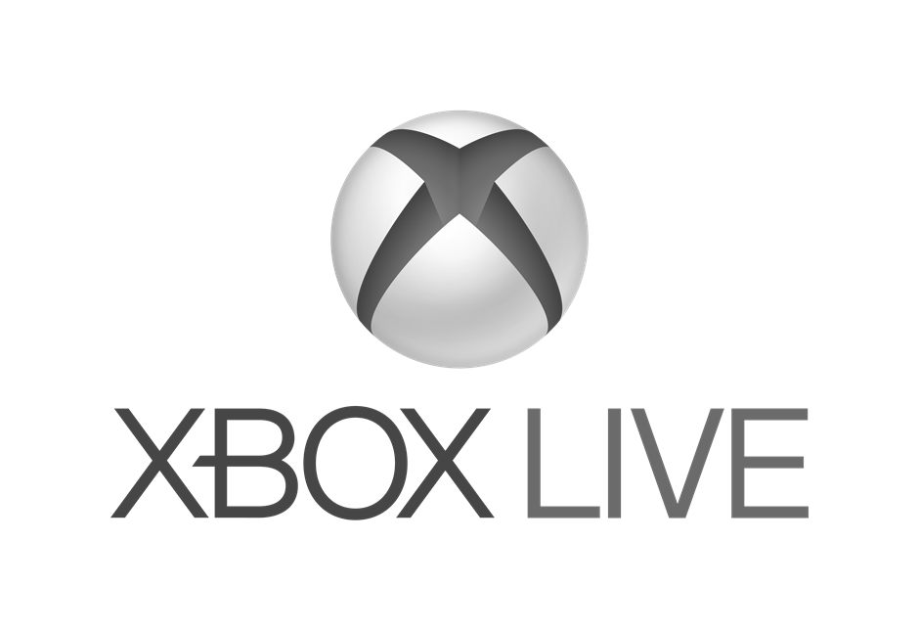

Windows does the heavy lifting for you
We translate and redirect Android concepts to Windows concepts
Sharing
Notifications
File system
Camera
User experience
Cloud services
Platform
Acquisition
Input and interaction
App-to-app interactions
Windowing & navigation
Notifications and live tiles
…
In-App Purchases
Ads
Maps
Game Services
Analytics
Notification service
…
File system
Contacts, photos,…
Sensors
Camera
Hardware accelerated graphics & Direct X
…

Slide 9
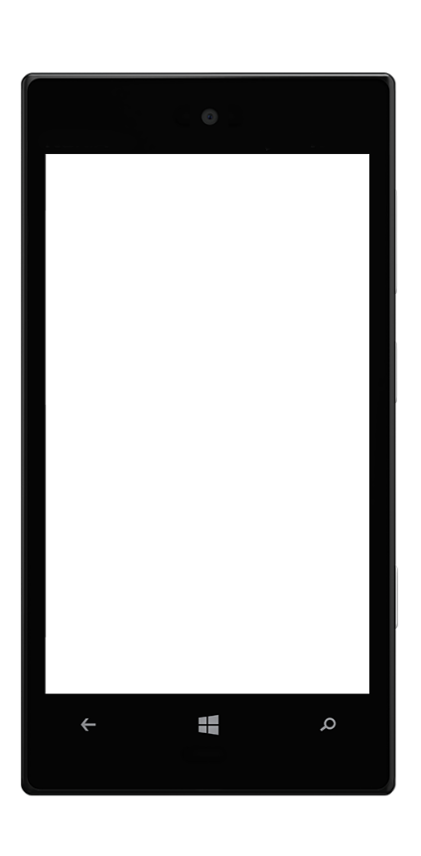
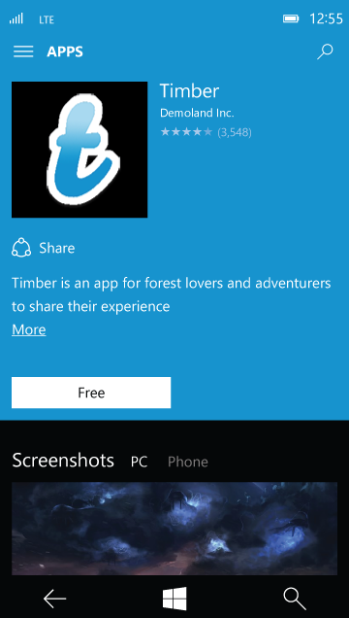

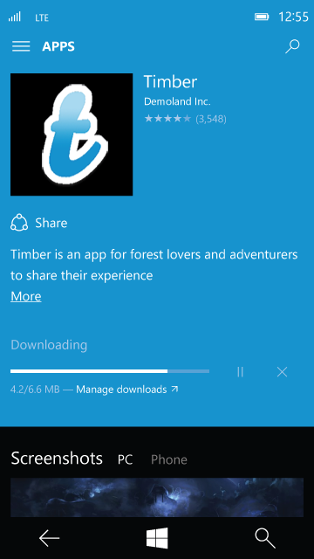
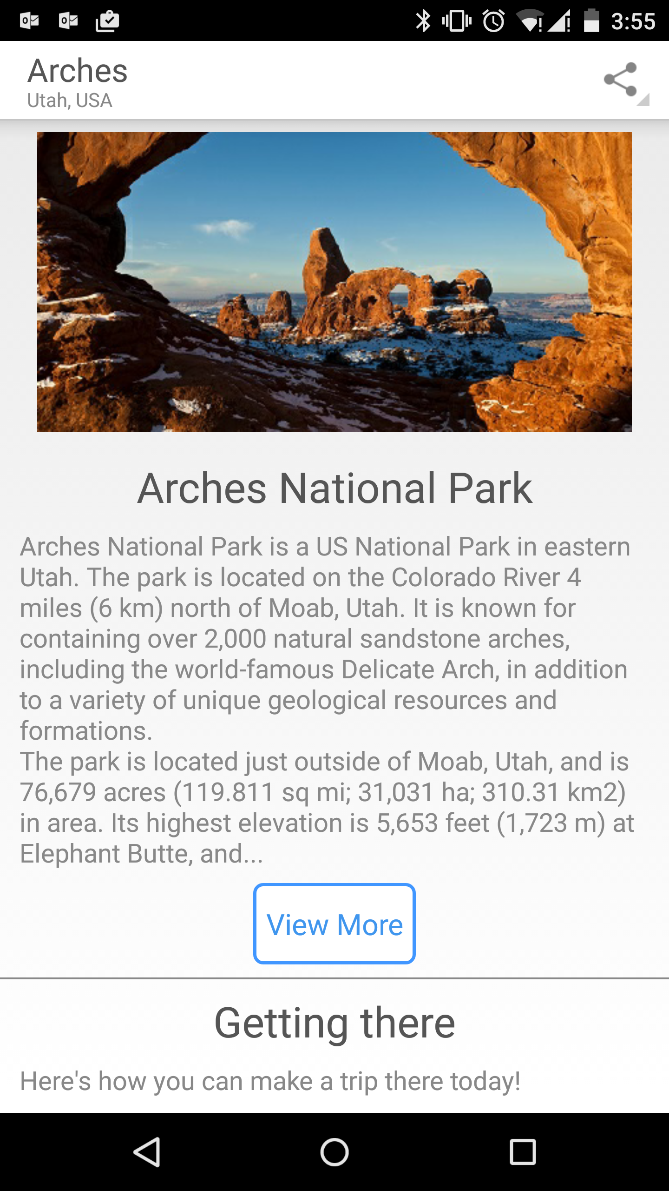
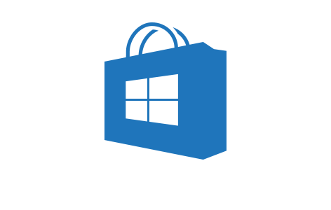
User experience
User experience
Cloud services
Apps built with Project Astoria are Windows apps
Platform
Contoso
Users acquire apps built with Project Astoria through the Windows Store

Slide 10
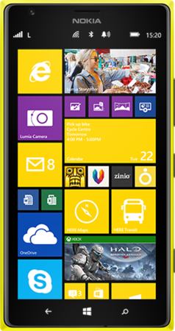
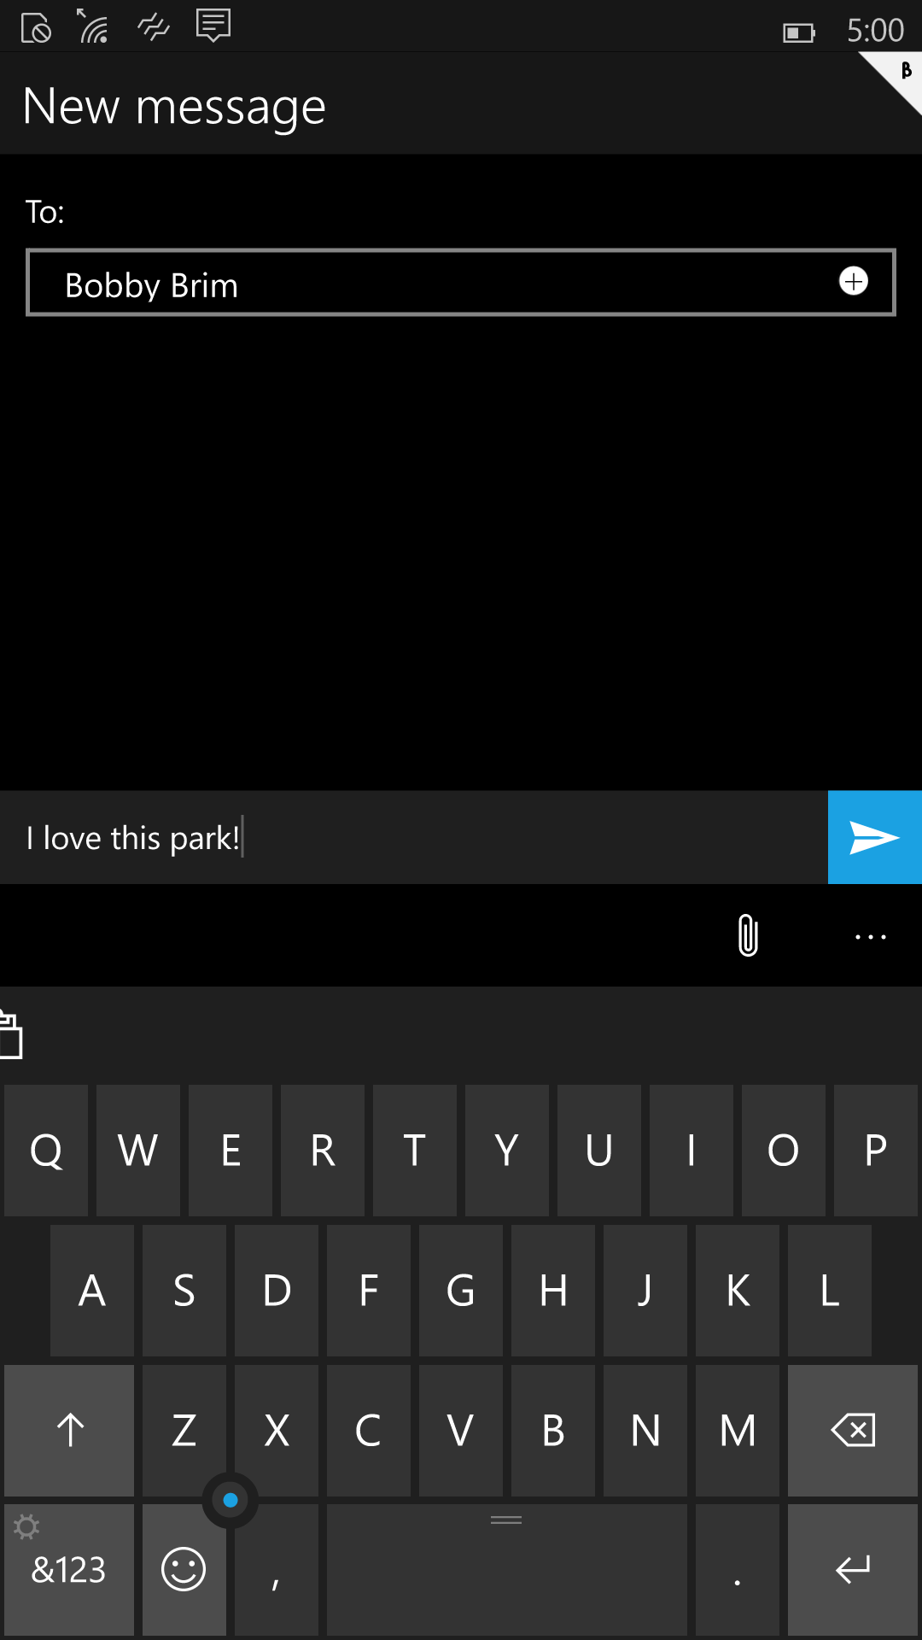
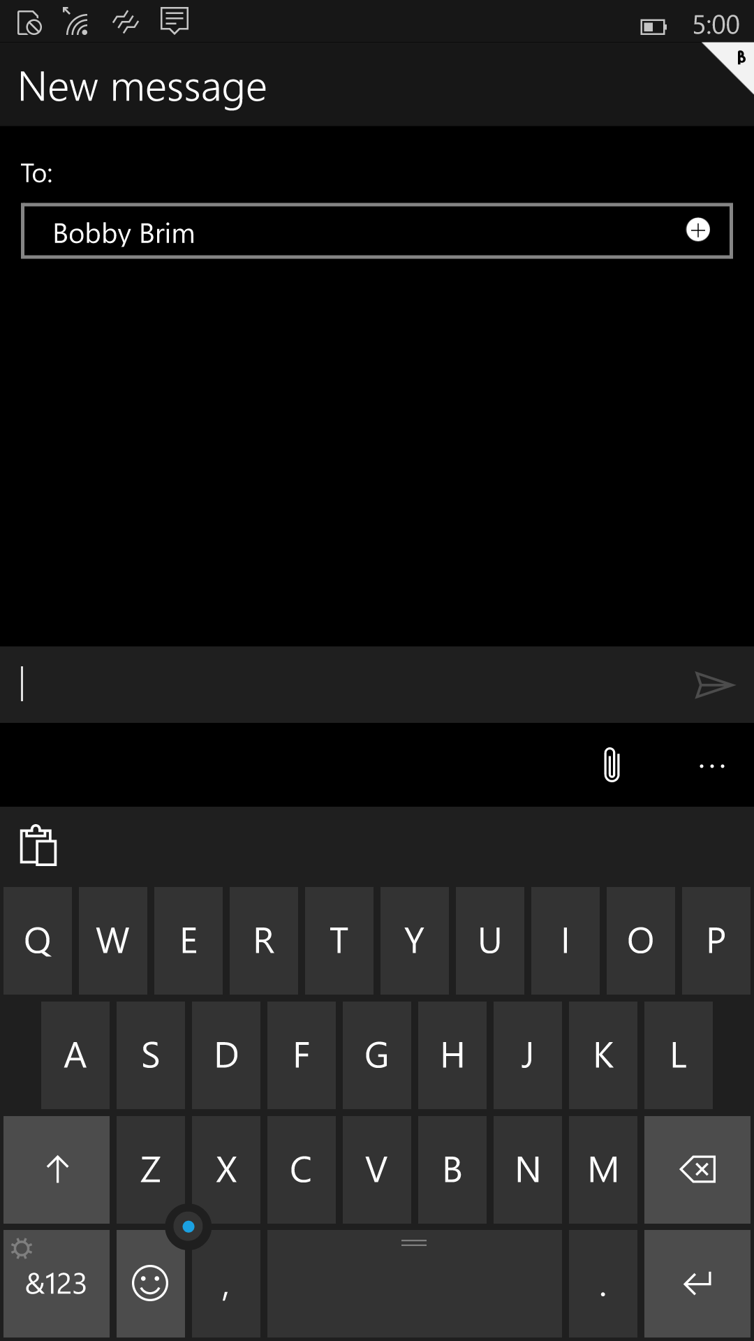
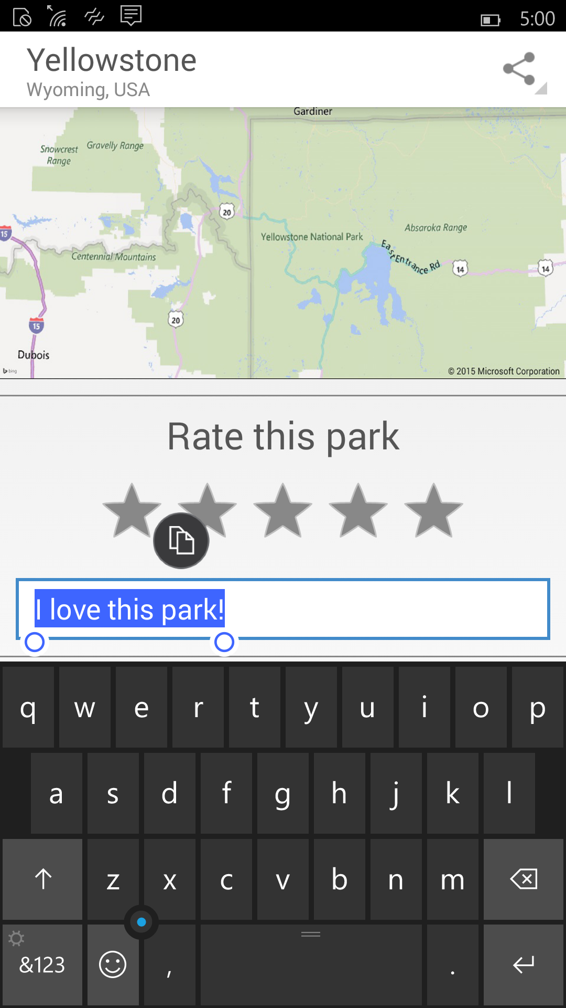
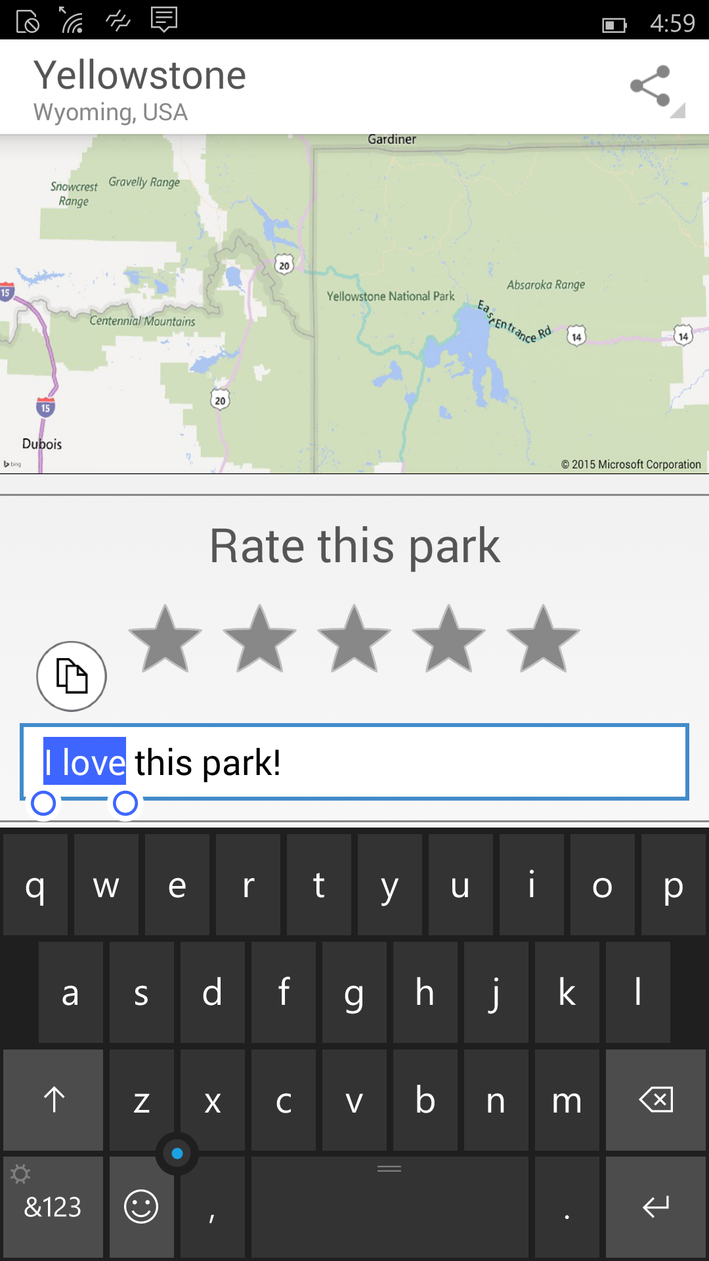
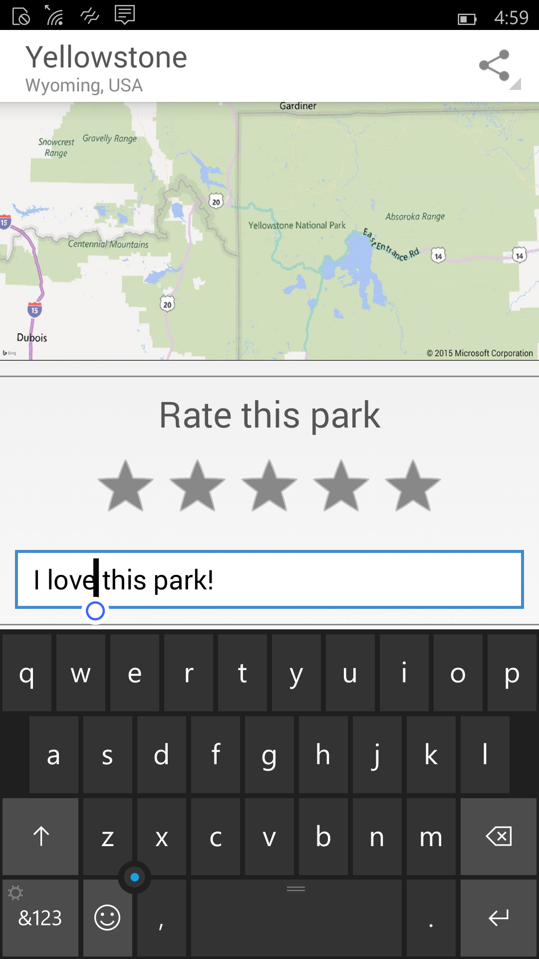
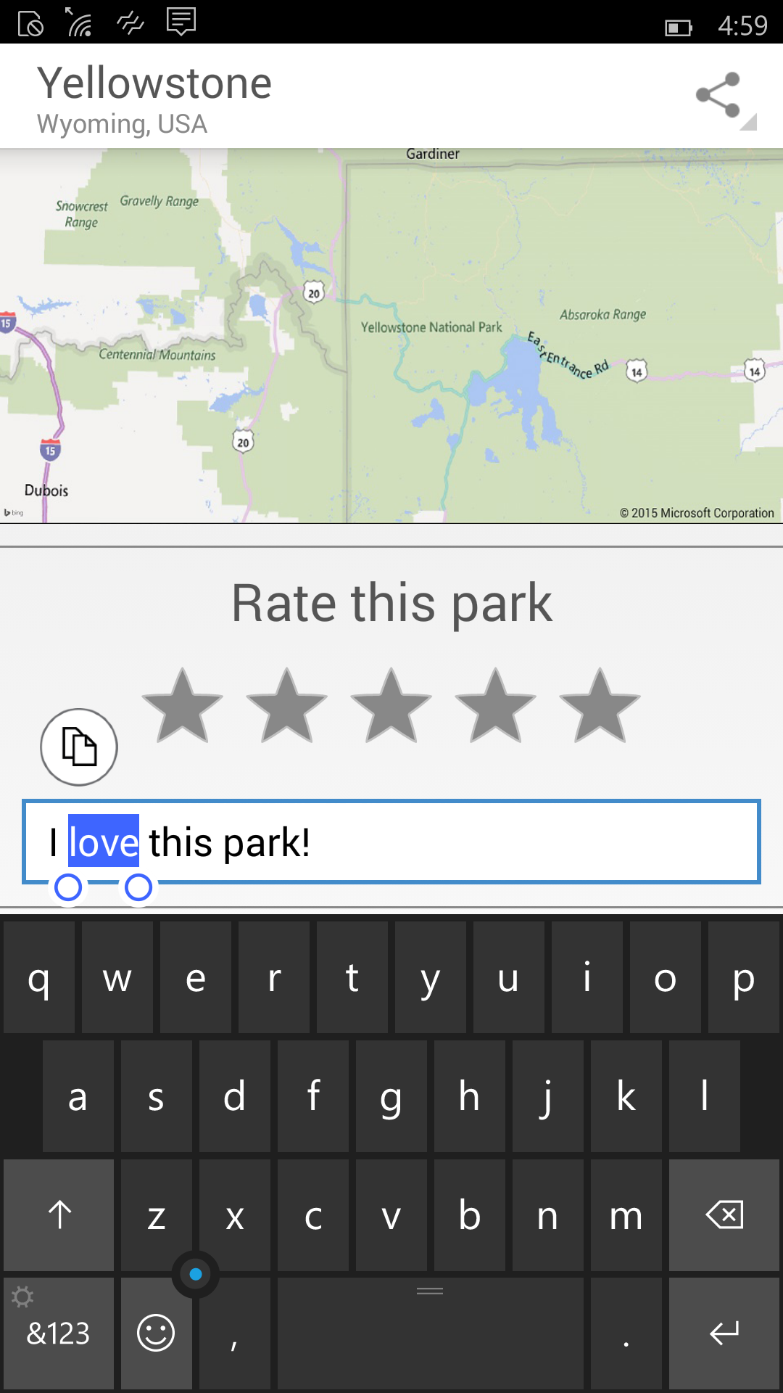
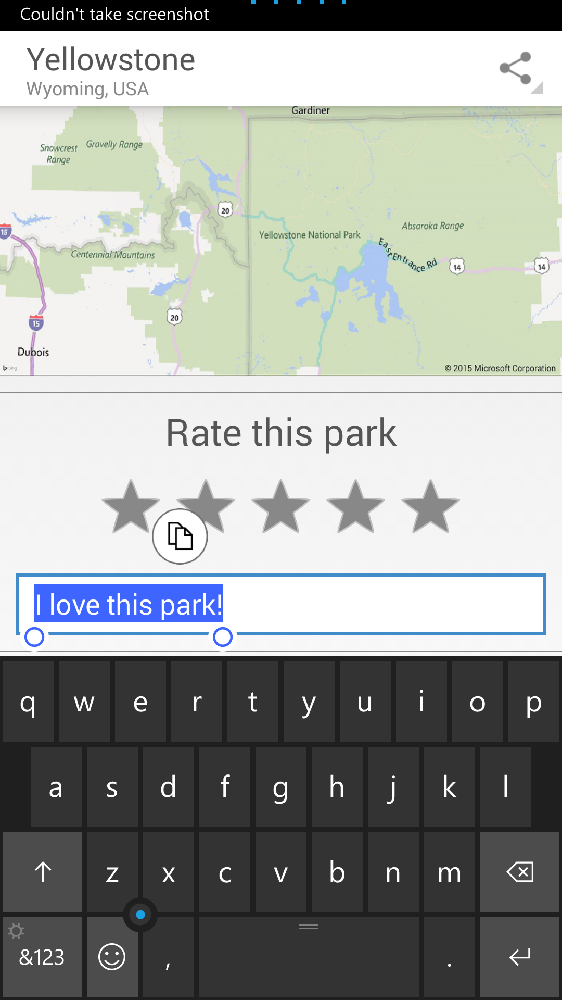
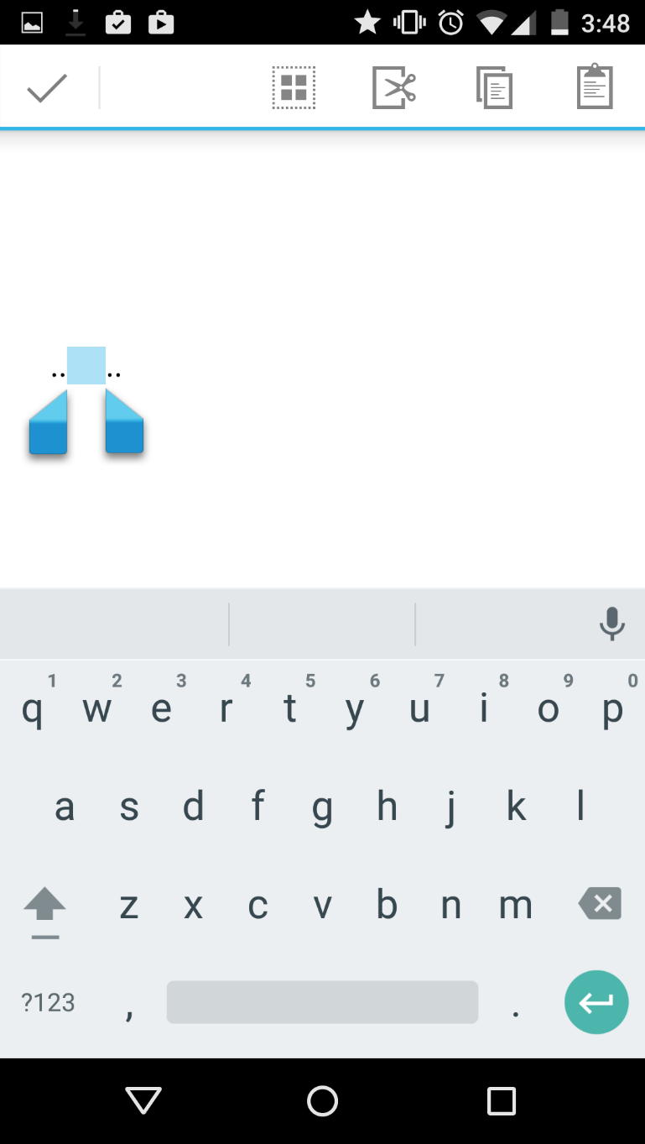

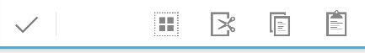
User experience
User experience (cont’d)
Cloud services
Apps built with Project Astoria are Windows apps
Platform
v/s
v/s
v/s

Slide 11
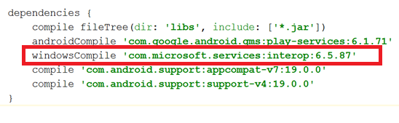
User experience
Cloud services
Cloud services
Windows apps built with Project Astoria use Microsoft cloud services
Platform
Microsoft Services
AppInsights
MS Ads
In-app Purchases
Windows Notification Service
Xbox Live Services
Bing Maps
Windows Location services
…
Project Astoria SDK in Java
Use Microsoft services with minimal code change
Get Started in Dev Center

Slide 12
User experience
Platform redirection
Cloud services
Android platform capabilities are redirected to Windows
Platform
APPX
APK
File system
Contacts, photos,…
Sensors
Camera
Hardware accelerated graphics & Direct X
Networking/sockets
Application lifecycle
Resource management
Background execution model
Security model
“PROJECT ASTORIA” SUBSYSTEM
WINDOWS

Slide 13
User experience
Performance and Battery
Cloud services
Platform
APPX
APK
Windows resource management
Runs directly on top of Windows kernel
“PROJECT ASTORIA” SUBSYSTEM
WINDOWS

Slide 14
User experience
A trustworthy user experience
Cloud services
Keeping users safe
Platform
Trusted Store
Secure Device
Monitoring & Response

Slide 15
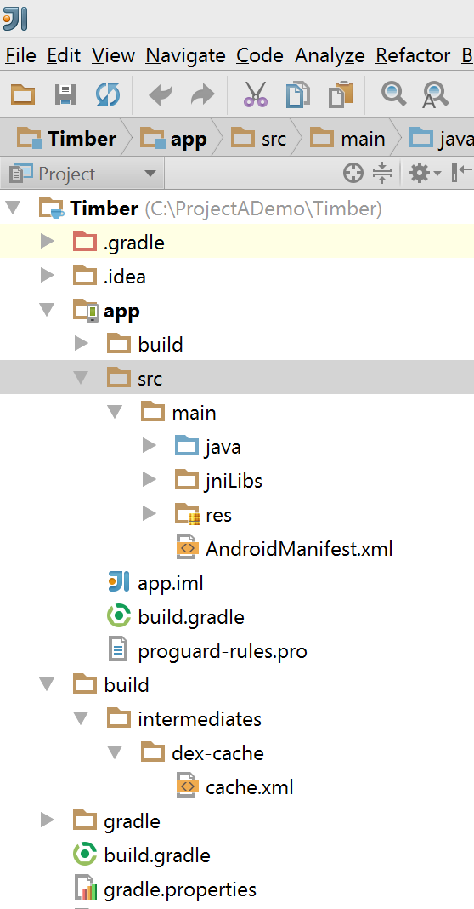
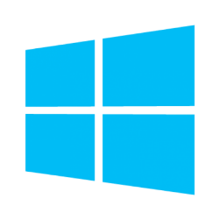
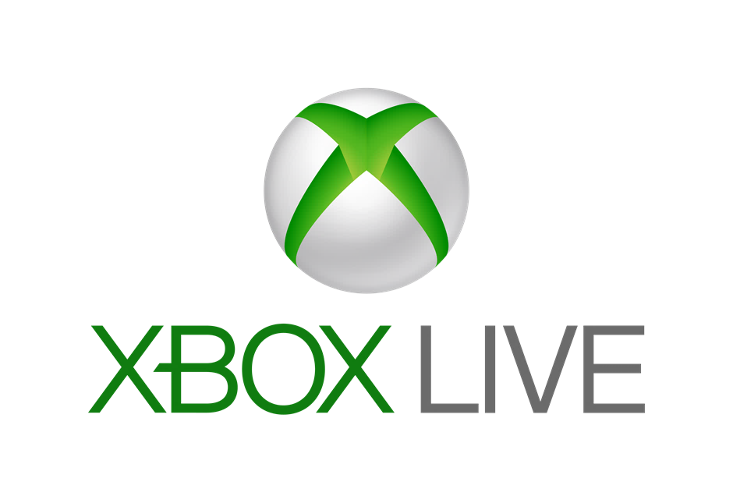
Project Astoria Recap
Build a Windows app with your Android code
Your Android Code
(Project Astoria SDK & App analysis)
Your IDE
(Project Astoria Plugins)
Your dev
machine
Windows
Magic
Your app in the Windows Store
IntelliJ
Android
Studio
Eclipse
Live tiles
Windows
Mac
+
+
+
…
Windows 10 Mobile Only

Slide 16
Windows Bridge for iOS (“Project Islandwood”)
Bring iOS applications to Windows
Windows Bridge for iOS (also referred to as WinObjC) is a Microsoft open source project that provides an Objective-C development environment for Visual Studio/Windows. In addition, WinObjC provides support for iOS API compatibility.
With the Windows Bridge for iOS you’ll be able to:
Import Xcode® projects into Visual Studio
Make minimal changes to your iOS/Objective-C code to build a Windows app
Build and debug your Objective-C code from Visual Studio
Take advantage of great Windows services
Extend your app to take advantage of Universal Windows Platform features
Developer Preview: https://github.com/Microsoft/WinObjC

Slide 17
Project Centennial
Make classic Windows apps -Win32, .NET, COM- run on the Universal Platform.
There are ~16M classic apps that could be ported with Centennial.
Project Centennial does not change anything in the code, it simply does some tricks to make app packaging and deployment run properly on UWP.
The Converter analyzes an MSI file, discovers and records what the app is doing during installation, what resources installs, what modifications it performs, etc. Then, an AppX is generated, including live tiles, which developers can test and load to the Store.
More details can be found by watching this Build 2015 session.

Slide 18
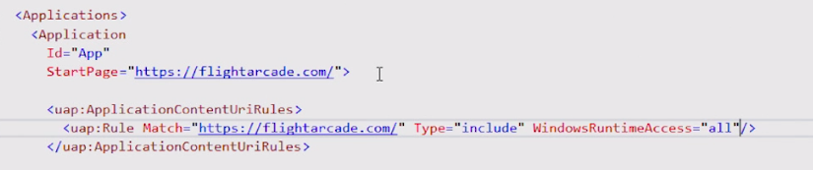
Project Westminster (Hosted Web Apps)
Packaging of a website as a universal application
The Windows Bridge for web apps makes it easy to publish your responsive web app to the Windows Store as a Universal Windows Platform (UWP) app, while reusing your existing code and workflow.
Easily scale your responsive web app to different devices.
Interact with native Windows APIs from JavaScript running on your website.
Integrate with Cortana voice commands.
Debug your app with Microsoft Edge F12 Developer Tools.
Track status, ratings, and reviews, see analytics, and get paid for all of your Windows app in the Windows Store.
Updates should be pushed to web-server not the app.

Slide 19
Project Westminster (Hosted Web Apps)
Invoke UWP API from remote JavaScript code
if (typeof Windows !== 'undefined'&&
typeof Windows.UI !== 'undefined' &&
typeof Windows.UI.Notifications !== 'undefined') {
var notifications = Windows.UI.Notifications,
tile = notifications.TileTemplateType.tileSquare150x150PeekImageAndText01,
tileContent = notifications.TileUpdateManager.getTemplateContent(tile),
tileText = tileContent.getElementsByTagName('text'),
tileImage = tileContent.getElementsByTagName('image');
tileText[0].appendChild(tileContent.createTextNode(message || 'Demo Message'));
tileImage[0].setAttribute('src', imgUrl || 'https://unsplash.it/150/150/?random');
tileImage[0].setAttribute('alt', imgAlt || 'Random demo image');
var tileNotification = new notifications.TileNotification(tileContent);
var currentTime = new Date();
tileNotification.expirationTime = new Date(currentTime.getTime() + 600 * 1000);
notifications.TileUpdateManager.createTileUpdaterForApplication().update(tileNotification);
}

Slide 20
Q&A
Oleksandr Krakovetskyi
CEO, DevRain Solutions
alex.krakovetskiy@devrain.com

